Slide 1

On the differentially private comparison of probability distributions
Mary Scott, Sayan Biswas, Graham Cormode, Carsten Maple
Theory Day 2023 (Thursday 8th June)

Slide 2
What will be covered in this talk?

Slide 3
What will be covered in this talk?
Motivation

Slide 4
What will be covered in this talk?
Motivation
Federated Learning

Slide 5
What will be covered in this talk?
Motivation
Federated Learning
KL Divergence

Slide 6
What will be covered in this talk?
Motivation
Federated Learning
KL Divergence
Naïve approach

Slide 7
What will be covered in this talk?
Motivation
Federated Learning
KL Divergence
Naïve approach
Improved approach

Slide 8
What will be covered in this talk?
Motivation
Federated Learning
KL Divergence
Naïve approach
Improved approach

Slide 9
Motivation

Slide 10
Motivation
Privately compare two different distributions

Slide 11
Motivation
Privately compare two different distributions
How about a distribution of data evolving with time?

Slide 12
Motivation
Privately compare two different distributions
How about a distribution of data evolving with time?
Application: max level of river over time to predict chance that flood will occur

Slide 13
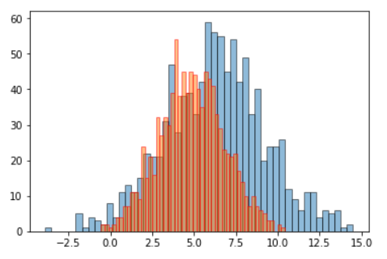
Motivation
Privately compare two different distributions
How about a distribution of data evolving with time?
Application: max level of river over time to predict chance that flood will occur
Credit: Cross Validated, Stack Exchange

Slide 14
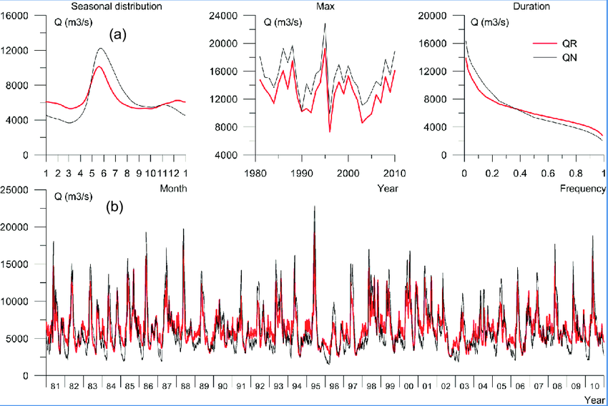
Credit: Arheimer, Berit, and Göran Lindström. “Electricity vs Ecosystems - understanding and predicting hydropower impact on Swedish river flow.” Proceedings of the International Association of Hydrological Sciences 364 (2014): 313-319.

Slide 15
(a) simulated average seasonal distribution, annual maximum, and flow duration for regulated and naturalized conditions, respectively, for total river-discharge from Sweden.
Credit: Arheimer, Berit, and Göran Lindström. “Electricity vs Ecosystems - understanding and predicting hydropower impact on Swedish river flow.” Proceedings of the International Association of Hydrological Sciences 364 (2014): 313-319.

Slide 16
(a) simulated average seasonal distribution, annual maximum, and flow duration for regulated and naturalized conditions, respectively, for total river-discharge from Sweden.
QR = modelled river flow including regulation;
QN = naturalized flow, both from HYPE simulations.
Credit: Arheimer, Berit, and Göran Lindström. “Electricity vs Ecosystems - understanding and predicting hydropower impact on Swedish river flow.” Proceedings of the International Association of Hydrological Sciences 364 (2014): 313-319.

Slide 17
(a) simulated average seasonal distribution, annual maximum, and flow duration for regulated and naturalized conditions, respectively, for total river-discharge from Sweden.
QR = modelled river flow including regulation;
QN = naturalized flow, both from HYPE simulations.
(b) daily time-series of the modelled period 1981-2010, with and without regulation.
Credit: Arheimer, Berit, and Göran Lindström. “Electricity vs Ecosystems - understanding and predicting hydropower impact on Swedish river flow.” Proceedings of the International Association of Hydrological Sciences 364 (2014): 313-319.

Slide 18
What will be covered in this talk?
Motivation
Federated Learning
KL Divergence
Naïve approach
Improved approach

Slide 19
Federated Learning

Slide 20
Federated Learning
Central server

Slide 21
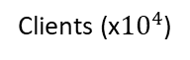
Federated Learning
Central server
Clients (x${10}^{4}$)

Slide 22
Federated Learning
I have a model
Central server
Clients (x${10}^{4}$)

Slide 23
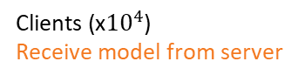
Send out model to clients
Federated Learning
Central server
Clients (x${10}^{4}$)
Receive model from server

Slide 24
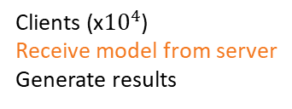
Send out model to clients
Federated Learning
Central server
Clients (x${10}^{4}$)
Receive model from server
Generate results

Slide 25
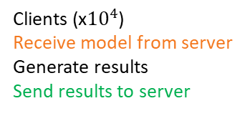
Send out model to clients
Receive results from clients
Federated Learning
Central server
Clients (x${10}^{4}$)
Receive model from server
Generate results
Send results to server

Slide 26
Send out model to clients
Receive results from clients
Federated Learning
Aggregation
Analysis
Improvements to model
Central server
Clients (x${10}^{4}$)
Receive model from server
Generate results
Send results to server

Slide 27
Federated Learning
I have an improved model
Central server
Clients (x${10}^{4}$)

Slide 28
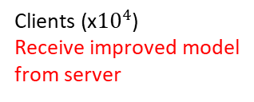
Send out improved model to clients
Federated Learning
Central server
Clients (x${10}^{4}$)
Receive improved model
from server

Slide 29
What will be covered in this talk?
Motivation
Federated Learning
KL Divergence
Naïve approach
Improved approach

Slide 30
KL Divergence

Slide 31
KL Divergence
One of the standard notions of distance between probability distributions

Slide 32

KL Divergence
One of the standard notions of distance between probability distributions
If $p$ and $q$ are full-support probability distributions on a finite domain $𝒳$,

Slide 33
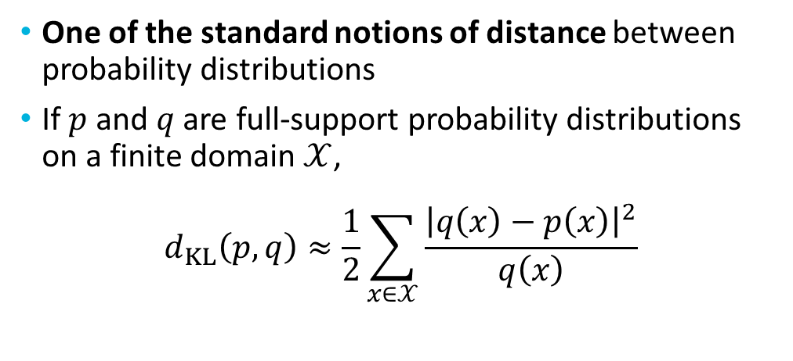
KL Divergence
One of the standard notions of distance between probability distributions
If $p$ and $q$ are full-support probability distributions on a finite domain $𝒳$,
$$d_{KL}\left(p,q\right)≈\frac{1}{2}\sum_{x∈𝒳}{\frac{{\left|q\left(x\right)−p\left(x\right)\right|}^{2}}{q\left(x\right)}}$$

Slide 34
What will be covered in this talk?
Motivation
Federated Learning
KL Divergence
Naïve approach
Improved approach

Slide 35
Naïve approach

Slide 36

Naïve approach
Assume $q$ is publicly known benchmark distribution

Slide 37

Naïve approach
Assume $q$ is publicly known benchmark distribution
$p$ is distribution described by clients involved in Federated Learning at any given time step

Slide 38
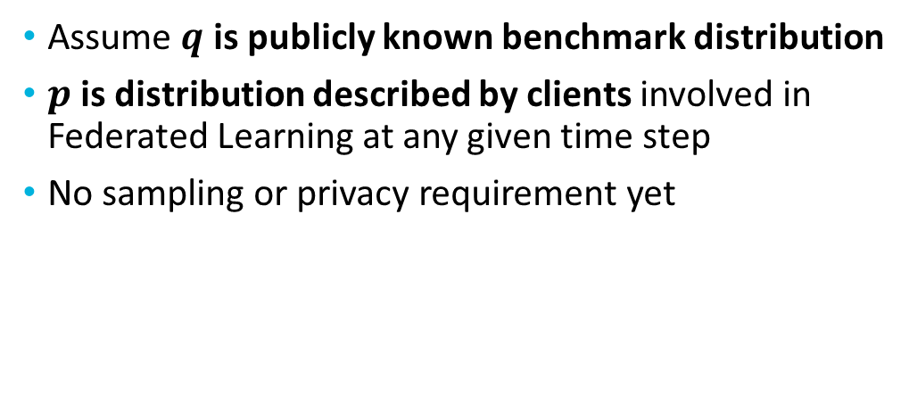
Naïve approach
Assume $q$ is publicly known benchmark distribution
$p$ is distribution described by clients involved in Federated Learning at any given time step
No sampling or privacy requirement yet

Slide 39
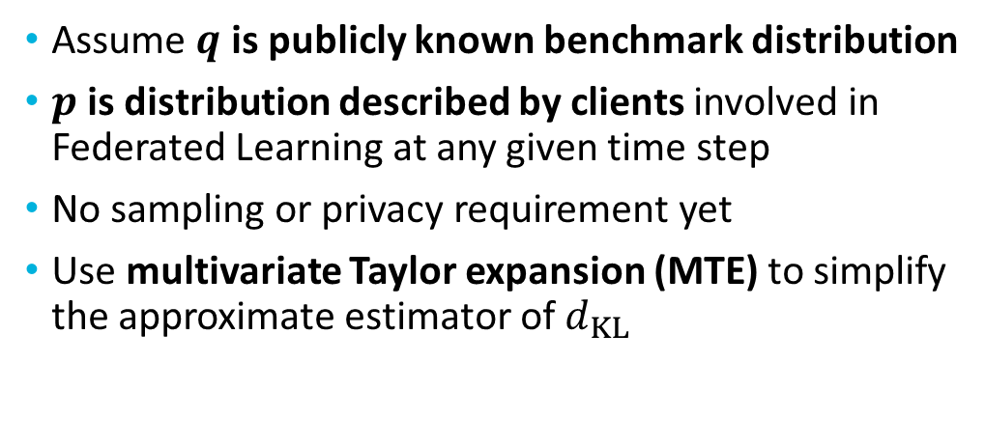
Naïve approach
Assume $q$ is publicly known benchmark distribution
$p$ is distribution described by clients involved in Federated Learning at any given time step
No sampling or privacy requirement yet
Use multivariate Taylor expansion (MTE) to simplify the approximate estimator of $d_{KL}$

Slide 40
Sketch of proof

Slide 41

Sketch of proof
$𝒫\left(𝒳\right)$ is space of full-support probability distributions on $𝒳$

Slide 42
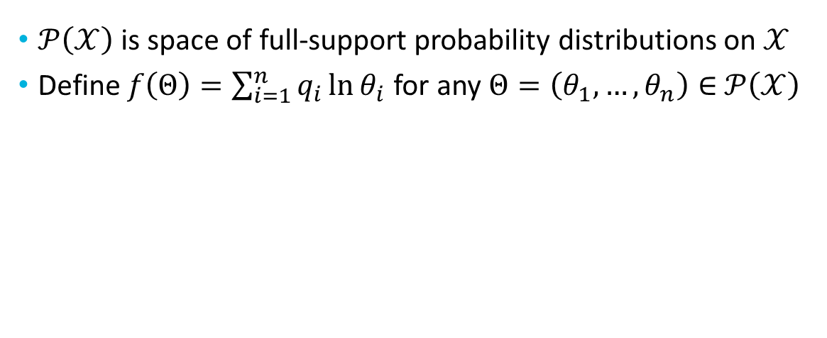
Sketch of proof
$𝒫\left(𝒳\right)$ is space of full-support probability distributions on $𝒳$
Define $f\left(Θ\right)=\sum_{i=1}^{n}{q_{i}\ln{θ_{i}}}$ for any $Θ=\left(θ_{1},…,θ_{n}\right)∈$ $𝒫\left(𝒳\right)$

Slide 43
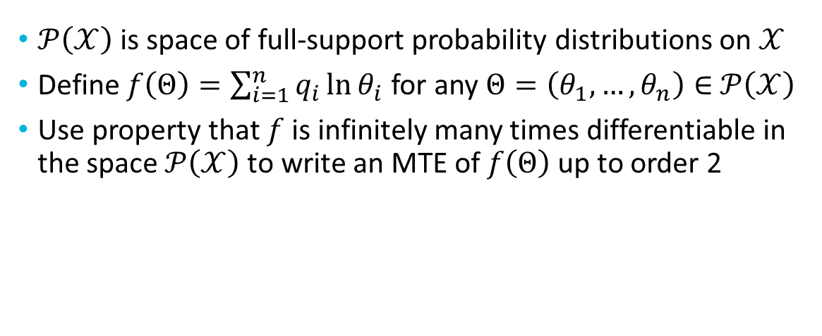
Sketch of proof
$𝒫\left(𝒳\right)$ is space of full-support probability distributions on $𝒳$
Define $f\left(Θ\right)=\sum_{i=1}^{n}{q_{i}\ln{θ_{i}}}$ for any $Θ=\left(θ_{1},…,θ_{n}\right)∈$ $𝒫\left(𝒳\right)$
Use property that $f$ is infinitely many times differentiable in the space $𝒫\left(𝒳\right)$ to write an MTE of $f\left(Θ\right)$ up to order 2

Slide 44
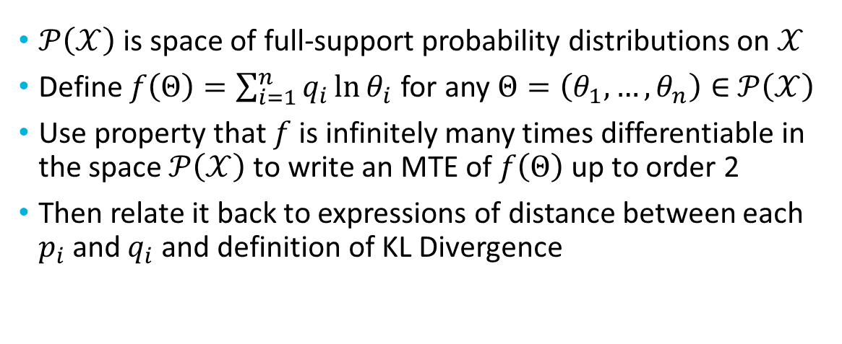
Sketch of proof
$𝒫\left(𝒳\right)$ is space of full-support probability distributions on $𝒳$
Define $f\left(Θ\right)=\sum_{i=1}^{n}{q_{i}\ln{θ_{i}}}$ for any $Θ=\left(θ_{1},…,θ_{n}\right)∈$ $𝒫\left(𝒳\right)$
Use property that $f$ is infinitely many times differentiable in the space $𝒫\left(𝒳\right)$ to write an MTE of $f\left(Θ\right)$ up to order 2
Then relate it back to expressions of distance between each $p_{i}$ and $q_{i}$ and definition of KL Divergence

Slide 45
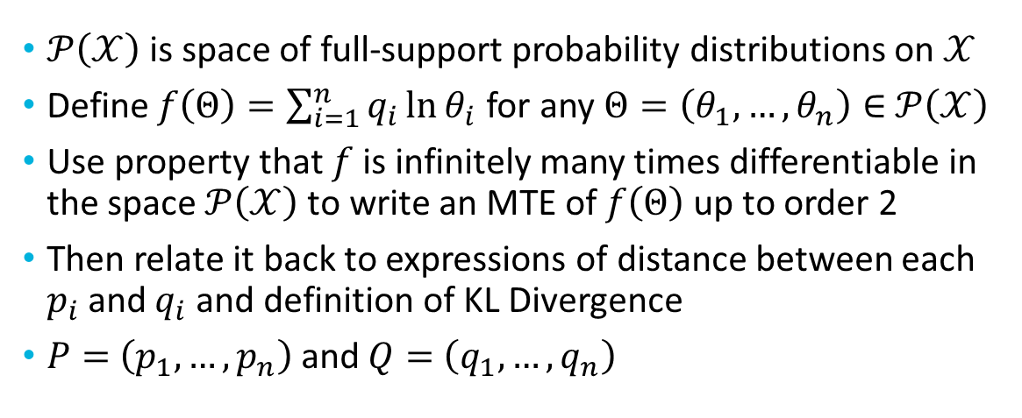
Sketch of proof
$𝒫\left(𝒳\right)$ is space of full-support probability distributions on $𝒳$
Define $f\left(Θ\right)=\sum_{i=1}^{n}{q_{i}\ln{θ_{i}}}$ for any $Θ=\left(θ_{1},…,θ_{n}\right)∈$ $𝒫\left(𝒳\right)$
Use property that $f$ is infinitely many times differentiable in the space $𝒫\left(𝒳\right)$ to write an MTE of $f\left(Θ\right)$ up to order 2
Then relate it back to expressions of distance between each $p_{i}$ and $q_{i}$ and definition of KL Divergence
$P=$ $\left(p_{1},…,p_{n}\right)$ and $Q=$ $\left(q_{1},…,q_{n}\right)$

Slide 46
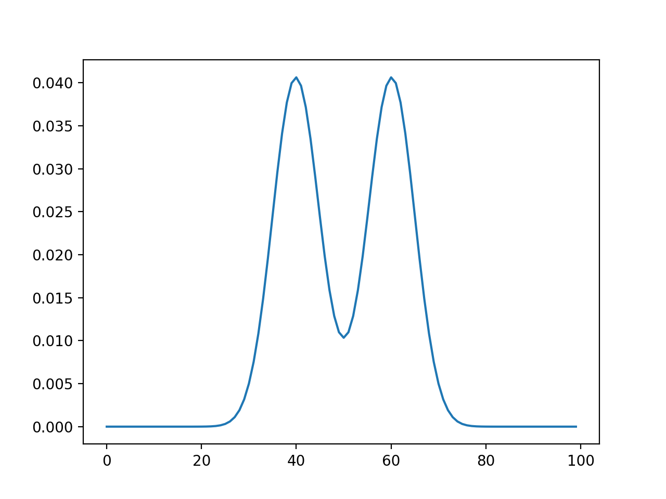
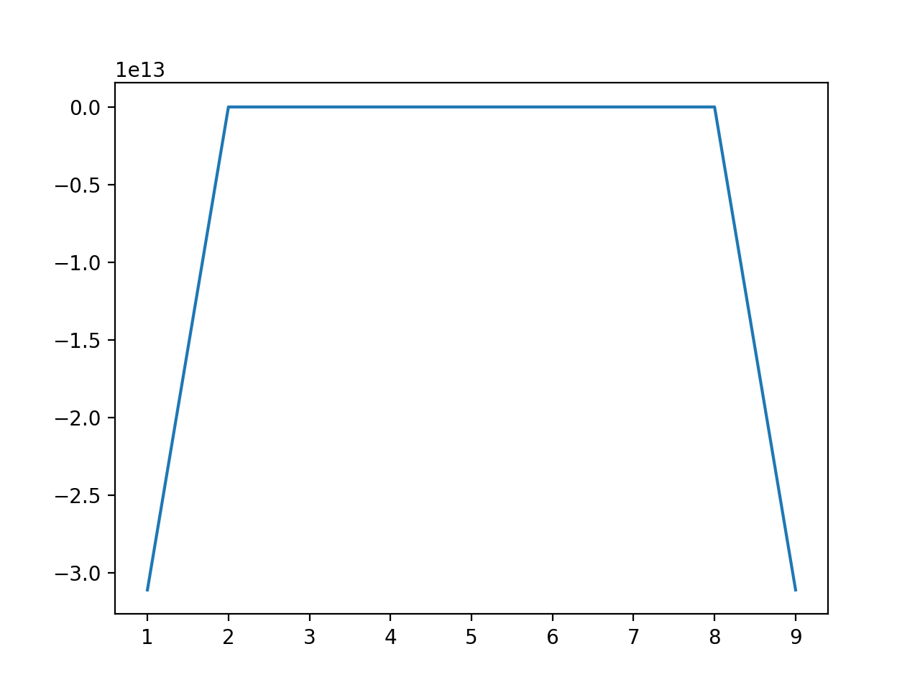
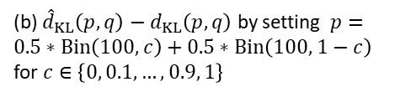
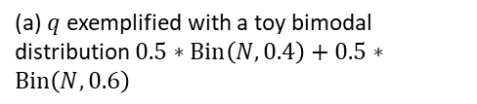
Credit: Sayan Biswas
Credit: Sayan Biswas
(a) $q$ exemplified with a toy bimodal distribution $0.5∗Bin\left(N,0.4\right)+0.5∗Bin\left(N,0.6\right)$
(b) ${\hat{d}}_{KL}\left(p,q\right)−d_{KL}\left(p,q\right)$ by setting $p=0.5∗Bin\left(100,c\right)+0.5∗Bin\left(100, 1−c\right)$ for $c∈\left\{0, 0.1,…,0.9, 1\right\}$

Slide 47
What will be covered in this talk?
Motivation
Federated Learning
KL Divergence
Naïve approach
Improved approach

Slide 48
Improved approach

Slide 49
Improved approach
Want to incorporate differential privacy (DP)

Slide 50
Improved approach
Want to incorporate differential privacy (DP)
Define adjacent histograms/distributions

Slide 51
Improved approach
Want to incorporate differential privacy (DP)
Define adjacent histograms/distributions
Restricted sensitivity space where each value occurs at least twice (to obtain finite upper bound)

Slide 52
Improved approach
Want to incorporate differential privacy (DP)
Define adjacent histograms/distributions
Restricted sensitivity space where each value occurs at least twice (to obtain finite upper bound)
Bound L1 sensitivity for KL Divergence

Slide 53
Improved approach
Want to incorporate differential privacy (DP)
Define adjacent histograms/distributions
Restricted sensitivity space where each value occurs at least twice (to obtain finite upper bound)
Bound L1 sensitivity for KL Divergence
Then compute noise required to achieve DP guarantee that corresponds to sensitivity bound

Slide 54
Upper bounds

Slide 55

Upper bounds
$T_{>1}=\left\{π:π∈𝒫\left(𝒳\right), ψ^{−1}\left(π\right)∈ℋ_{>1}\right\}$

Slide 56

Upper bounds
$T_{>1}=\left\{π:π∈𝒫\left(𝒳\right), ψ^{−1}\left(π\right)∈ℋ_{>1}\right\}$
$ℋ_{>1}$ is restricted sensitivity space

Slide 57

Upper bounds
$T_{>1}=\left\{π:π∈𝒫\left(𝒳\right), ψ^{−1}\left(π\right)∈ℋ_{>1}\right\}$
$ℋ_{>1}$ is restricted sensitivity space
Fixing $ℋ_{>1}$ such that $N=\left|h\right|$ for $h∈ℋ_{>1}$, we have:

Slide 58
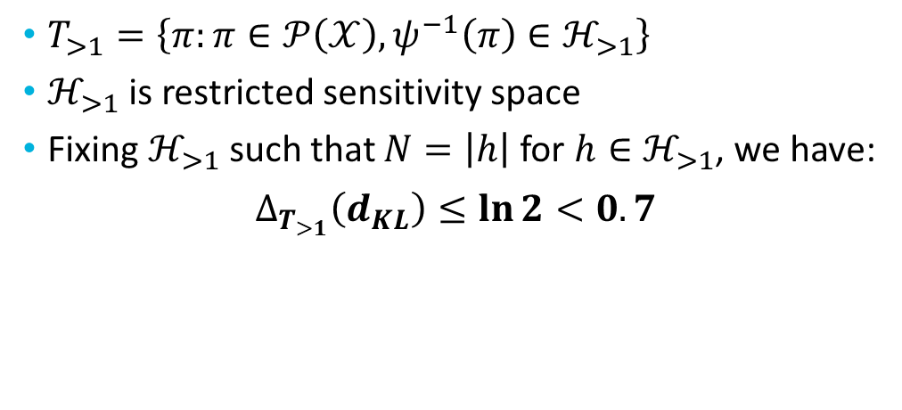
Upper bounds
$T_{>1}=\left\{π:π∈𝒫\left(𝒳\right), ψ^{−1}\left(π\right)∈ℋ_{>1}\right\}$
$ℋ_{>1}$ is restricted sensitivity space
Fixing $ℋ_{>1}$ such that $N=\left|h\right|$ for $h∈ℋ_{>1}$, we have:
$$∆_{T_{>1}}\left(d_{KL}\right)≤\ln{2<0.7}$$

Slide 59
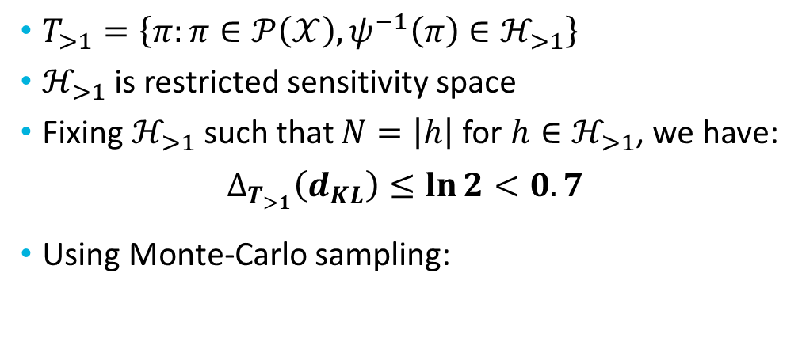
Upper bounds
$T_{>1}=\left\{π:π∈𝒫\left(𝒳\right), ψ^{−1}\left(π\right)∈ℋ_{>1}\right\}$
$ℋ_{>1}$ is restricted sensitivity space
Fixing $ℋ_{>1}$ such that $N=\left|h\right|$ for $h∈ℋ_{>1}$, we have:
$$∆_{T_{>1}}\left(d_{KL}\right)≤\ln{2<0.7}$$
Using Monte-Carlo sampling:

Slide 60
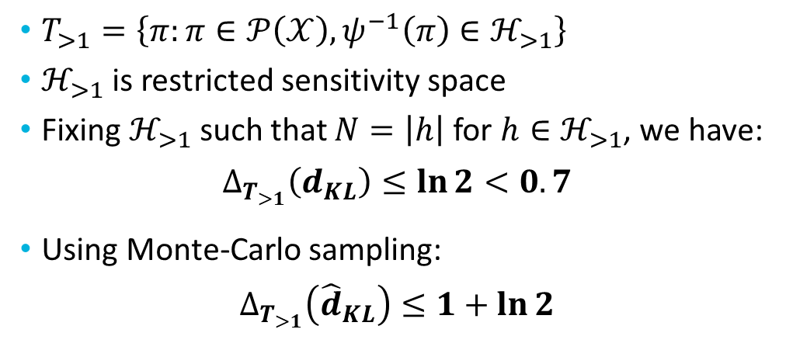
Upper bounds
$T_{>1}=\left\{π:π∈𝒫\left(𝒳\right), ψ^{−1}\left(π\right)∈ℋ_{>1}\right\}$
$ℋ_{>1}$ is restricted sensitivity space
Fixing $ℋ_{>1}$ such that $N=\left|h\right|$ for $h∈ℋ_{>1}$, we have:
$$∆_{T_{>1}}\left(d_{KL}\right)≤\ln{2<0.7}$$
Using Monte-Carlo sampling:
$$∆_{T_{>1}}\left({\hat{d}}_{KL}\right)≤1+\ln{2}$$

Slide 61
Derivation of DP parameters

Slide 62
Derivation of DP parameters
Can either:

Slide 63

Derivation of DP parameters
Can either:
add noise from Laplace distribution to provide $ε$-DP (pure-DP)

Slide 64
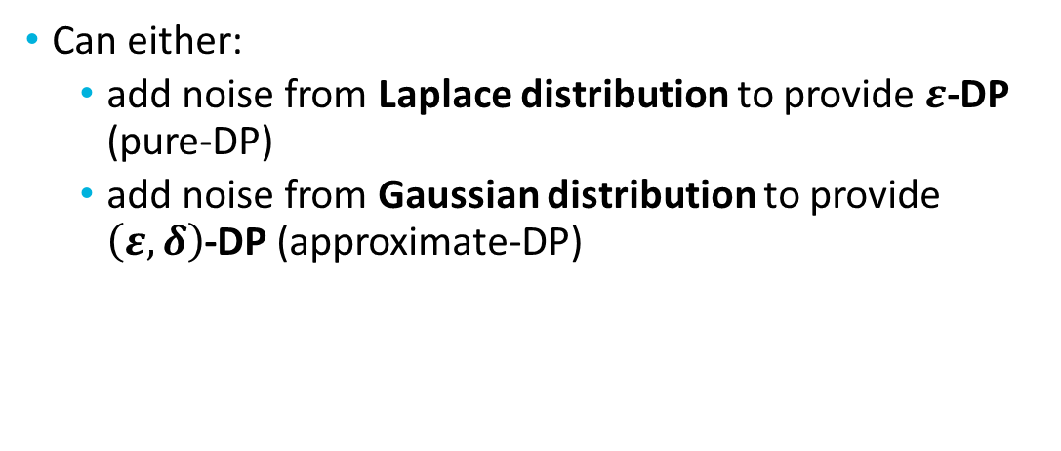
Derivation of DP parameters
Can either:
add noise from Laplace distribution to provide $ε$-DP (pure-DP)
add noise from Gaussian distribution to provide $\left(ε,δ\right)$-DP (approximate-DP)

Slide 65
Derivation of DP parameters
Can either:
add noise from Laplace distribution to provide $ε$-DP (pure-DP)

Slide 66
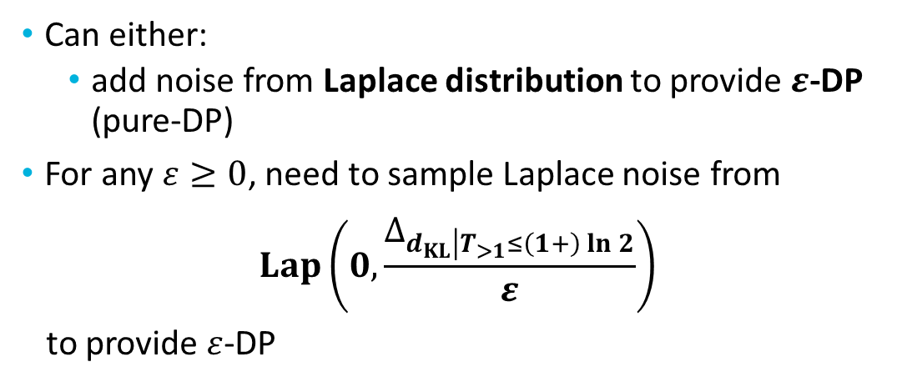
Derivation of DP parameters
Can either:
add noise from Laplace distribution to provide $ε$-DP (pure-DP)
For any $ε≥0$, need to sample Laplace noise from
$$Lap\left(0,\frac{∆_{d_{KL}\left|T_{>1}≤\left(1+\right)\ln{2}\right.}}{ε}\right)$$
to provide $ε$-DP

Slide 67

Derivation of DP parameters
add noise from Gaussian distribution to provide $\left(ε,δ\right)$-DP (approximate-DP)

Slide 68
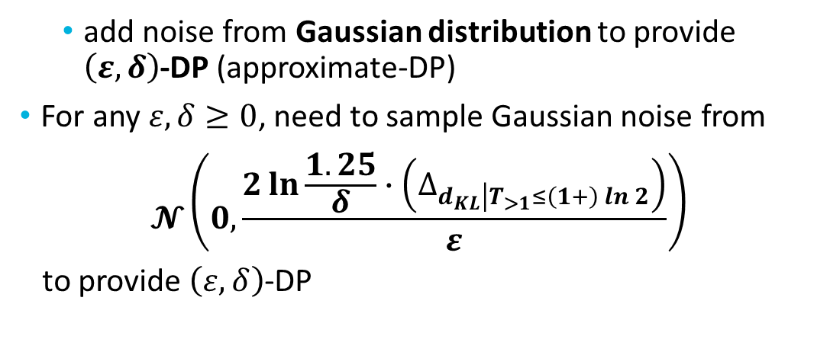
Derivation of DP parameters
add noise from Gaussian distribution to provide $\left(ε,δ\right)$-DP (approximate-DP)
For any $ε,δ≥0$, need to sample Gaussian noise from
$$𝓝\left(0,\frac{2\ln{\frac{1.25}{δ}}∙\left(∆_{d_{KL}\left|T_{>1}≤\left(1+\right)\ln{2}\right.}\right)}{ε}\right)$$
to provide $\left(ε,δ\right)$-DP

Slide 69
Full distribution vs Monte-Carlo sampling

Slide 70
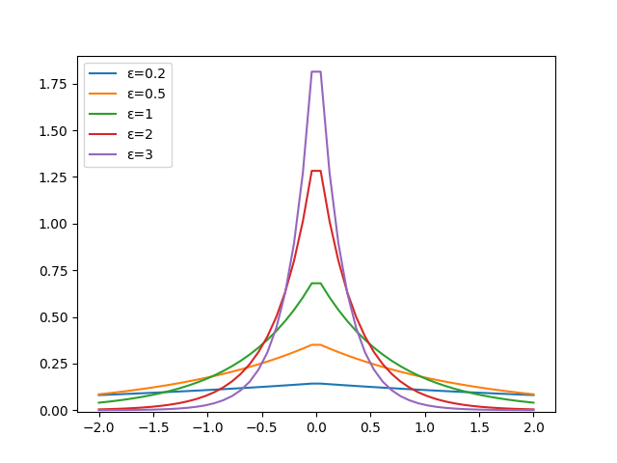
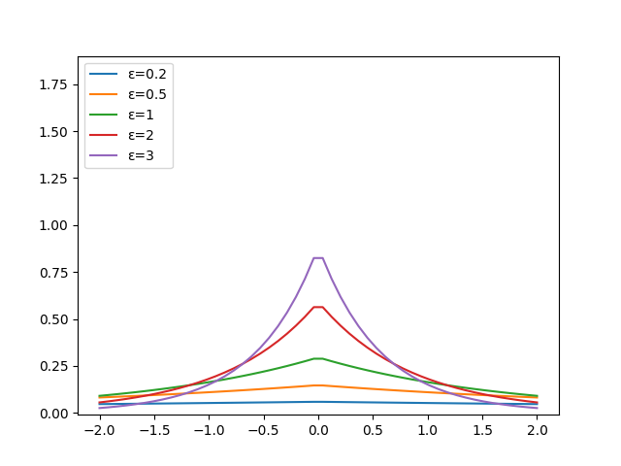

Full distribution vs Monte-Carlo sampling
Laplace graphs based on sensitivity analysis for different values of $ε$ with (i) full distribution (ii) Monte-Carlo sampling

Slide 71
What next?

Slide 72
What next?
Privately estimate KL Divergence with sampling in a multi-server environment

Slide 73
What next?
Privately estimate KL Divergence with sampling in a multi-server environment
Investigate family of distributions (e.g. exponential)

Slide 74
What next?
Privately estimate KL Divergence with sampling in a multi-server environment
Investigate family of distributions (e.g. exponential)
Comparison between value and noise

Slide 75
What next?
Privately estimate KL Divergence with sampling in a multi-server environment
Investigate family of distributions (e.g. exponential)
Comparison between value and noise
Theorem about “almost no utility loss” with a particular privacy guarantee

Slide 76

Thank you for listening
Any questions?
Mary.P.Scott@warwick.ac.uk

